Slide 1
The Role of Data Stewards
FAIRsFAIR, EOSC-Synergy Data Steward Training
Joy Davidson, Digital Curation Centre and FAIRsFAIR project.
Gratefully acknowledging reuse of slides from FAIRsFAIR colleagues Angus Whyte, Patricia Herterich and Marjan Grootveld.

Slide 2
Where do Data Stewards fit into the landscape?
Slide from ‘RDM Skills’, Sarah Jones https://www.slideshare.net/sjDCC/rdm-skills

Slide 3
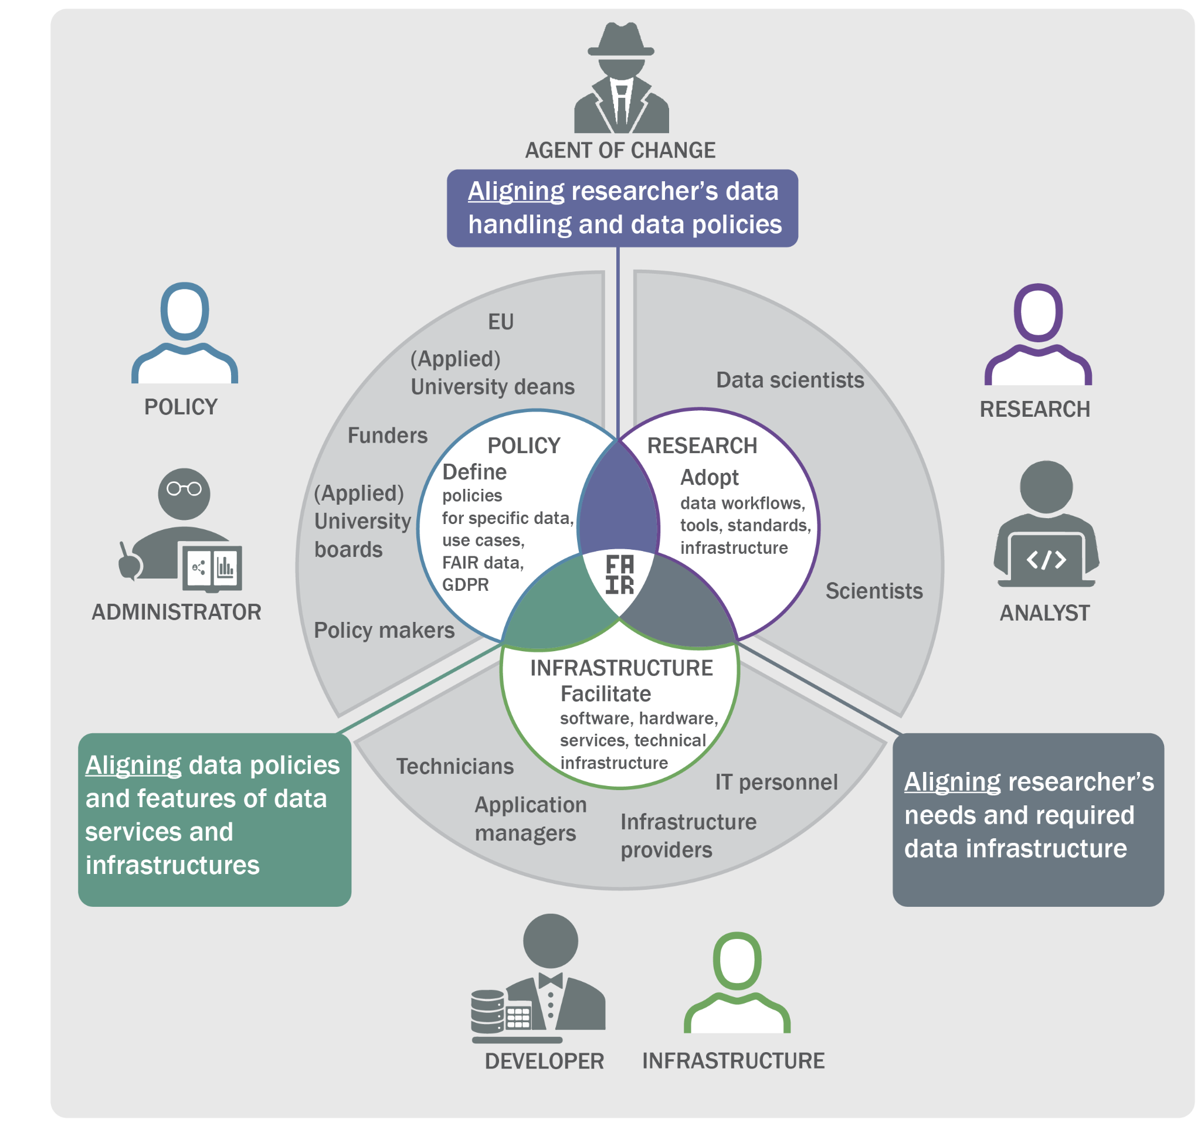
Pointers from the Dutch Landscape
No single model for how these roles are situated in institutions
Some focus on policy, others on infrastructure, or research
Can be embedded or generic
ZonMW/ ELIXIR: Scholtens, S., Jetten, M., Böhmer, J., Staiger, Ch.,Slouwerhof, I., Van der Geest, M. & Van Gelder, C.W.G. (2019, October 3). Final report: Towards FAIR data steward as profession for the lifesciences.Report of a ZonMw funded collaborative approach built on existing expertise.http://doi.org/10.5281/zenodo.3474789

Slide 4
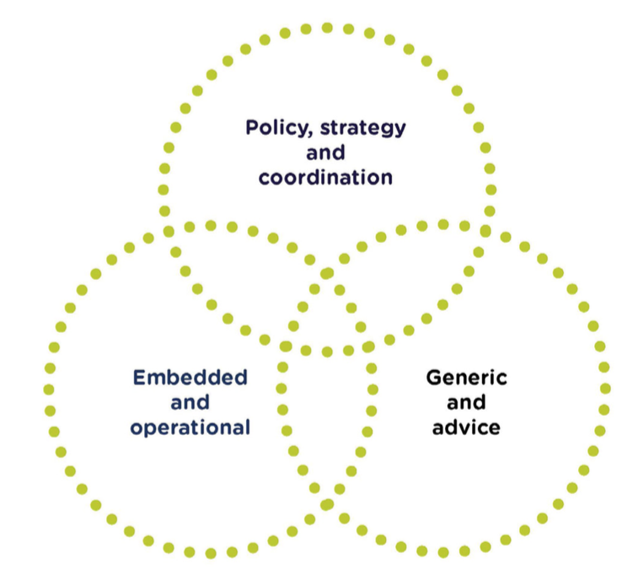
Tasks and roles in Dutch research institutes
Generic data steward
central support service or at faculty level
helps researchers with all kinds of data related questions
supplies information and training with regard to policy requirements and guidelines
helps to draw up data management plans
Embedded data steward
directly involved with research being carried out
familiar with the specific needs of fellow researchers within the relevant domain
translates generic data policy so it can be practically implemented.
Verheul, I., Imming, M., Ringersma, J., Mordant, A., Ploeg, J. van der, & Pronk, M. (2019, May 6). Data Stewardship on the map: A study of tasks and roles in Dutch research institutes. Zenodo. http://doi.org/10.5281/zenodo.2669150

Slide 5
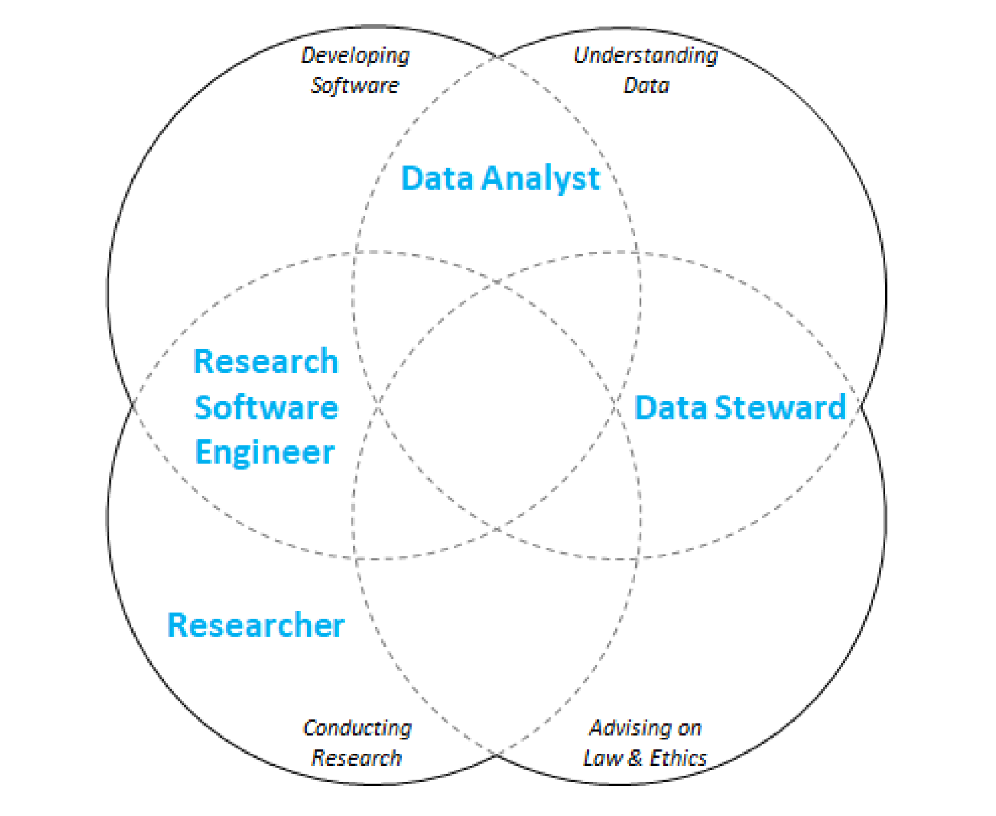
Stewardship - overlapping roles and responsibilities
Data steward as intermediary role
Often first point of contact for researchers to get help
Some roles moving toward more research and technical aspects
Figure 3 from OECD (2020), "Building digital workforce capacity and skills for data-intensive science", OECD Science, Technology and Industry Policy Papers, No. 90, OECD Publishing, Paris, https://doi.org/10.1787/e08aa3bb-en

Slide 6
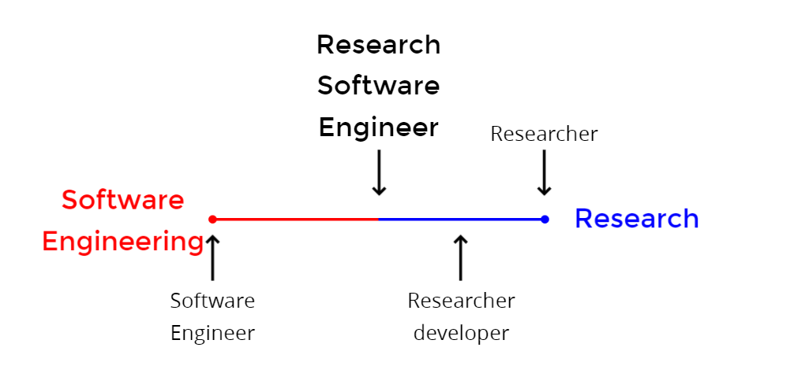
What is a Research Software Engineer?
“A Research Software Engineer (RSE) combines professional software engineering expertise with an intimate understanding of research.”

Slide 7
No single blueprint for data stewardship provision
Slide from ‘RDM Skills’, Sarah Jones https://www.slideshare.net/sjDCC/rdm-skills

Slide 8
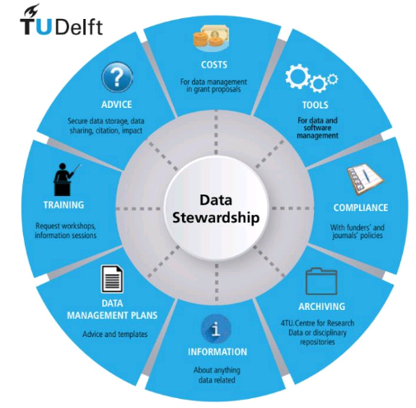
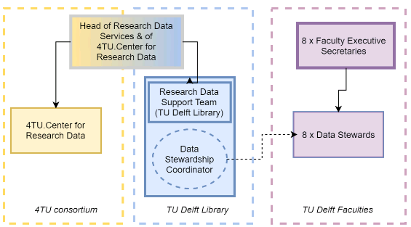
TU Delft example
https://www.openaire.eu/blogs/setting-up-a-data-stewardship-programme-an-institutional-perspective

Slide 9
Currently, role largely depends on needs of employer
71 UK job adverts relating to open research scholarly communications services were collected. In title or description:
Open Access, Repository (-ies), Research Data Manager, Scholarly Communications, Research Publications, Research Services, Research Support, and Research.
Defined subfields: Open Access, Repositories, RDM
Common for the RDM role to be advertised in connection with one of the other two roles, (i.e. open access or repository manager)
Pontika, N., 2019. Roles and jobs in the open research scholarly communications environment: analysing job descriptions to predict future trends. LIBER Quarterly, 29(1), pp.1–20. DOI: http://doi.org/10.18352/lq.10282

Slide 10
Focus on the basics first and build from there
Slide from ‘What it means to be FAIR’, Sarah Jones https://www.slideshare.net/sjDCC/what-it-means-to-be-fair?

