Slide 1
EOSC in practice:
EOSC Synergy
Horizon 2020 Research and Innovation Programme
Grant Agreement # 857647

Slide 2
Learning outcomes
Identify the underlying reasons behind EOSC Synergy and its innovative thematic services in the wider context of the European Open Science Cloud.
Understand what thematic services EOSC Synergy will offer to end users.
Understand the added value of thematic services to end users.

Slide 3
Snapshot
What is EOSC Synergy?
Putting EOSC in practice
Thematic services
Water Monitoring Sentinel Cloud platform (WORSICA)
Learn more

Slide 4
What is EOSC Synergy?
Launched in 2019 and spanning over 3 years, involves 8 Member States.
The project aims to expand the capacity and capabilities of EOSC by leveraging the experience, effort and resources of national publicly-funded digital infrastructures.
As an e-infrastructure, EOSC Synergy fosters EOSC services integration, promotes quality, harmonises EOSC policy, and develops EOSC human capital.

Slide 5
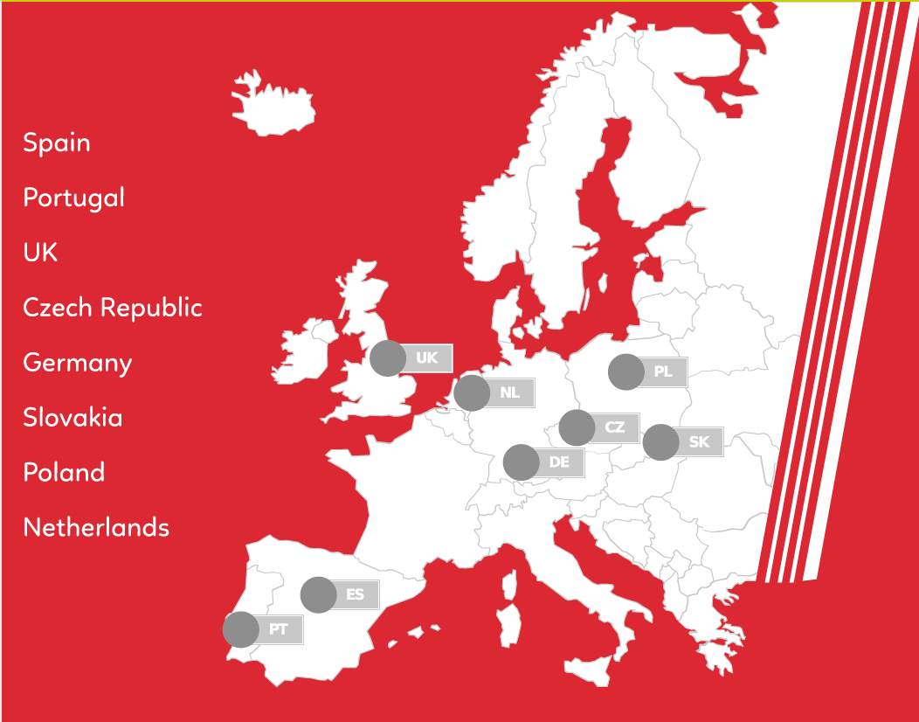
Putting EOSC in practice
EOSC supports the vision of EOSC by:
Preparing digital technologies to deliver services to researchers in line with the principles of Open Science.
Supporting observational, experimental and simulated data by latest technologies for transfer and storage.
Making data preservation as a service for all researchers.
Supporting advanced research projects by cutting-edge computing infrastructures.
Developing state-of-the-art software to enable technology.
Sreamlining collaboration to solve fundamental problems in science and societal challenges.

Slide 6
Thematic services virtuous cycle
04
Increase relevance of National Thematic Services
By expanding the use of the mature national services in an international scope.
Increase the capacity, performance, reliability and/or functionality
By means of best practices for adopting common EOSC core tools and services.
Earth Observ.
Environment
01
03
Biomedicine
Astrophysics
Increase service quality
FAIR data practices and software quality assessment.
Increase the number of users
By means of the integration in EOSC and the training.
02

Slide 7
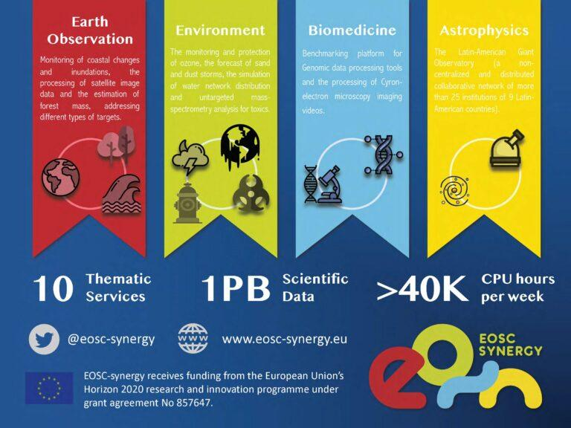
Thematic services
EOSC Synergy raises awareness on EOSC among researchers by offering quality certified services.
In 2021, 10 thematic services in 4 scientific areas will help serve the needs of scientific communities.
Thematic services gather and expose data and computing services directly to researchers in a user-friendly interface.
The architecture of thematic services is evolving to operate within EOSC framework leading to higher performance and capacity, resilience and economy of scale.
Scientific applications also interact with EOSC federation services: standard authorisation and authentication, monitoring or security.
Notes:
https://www.eosc-synergy.eu/eosc-synergy-and-its-10-thematic-services/

Slide 8
Learn more
EOSC Synerg:, https://www.eosc-synergy.eu/about
EOSC Synergy (thematic services): https://www.eosc-synergy.eu/eosc-synergy-and-its-10-thematic-service

