Slide 1
Want to learn how to be more FAIR?
Try FAIR-Aware
Linas Čepinskas, Policy Officer - Training and Skills, DANS, The Netherlands

Slide 2
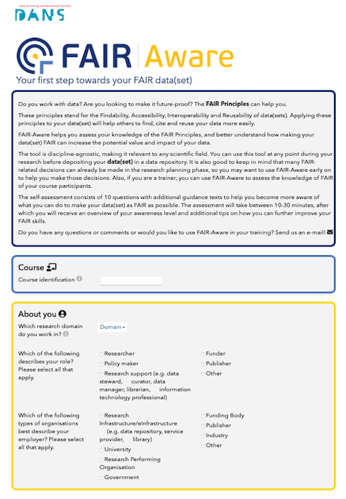
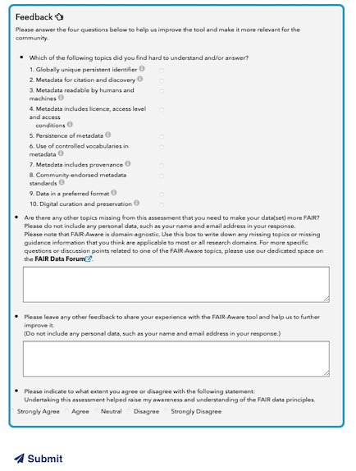
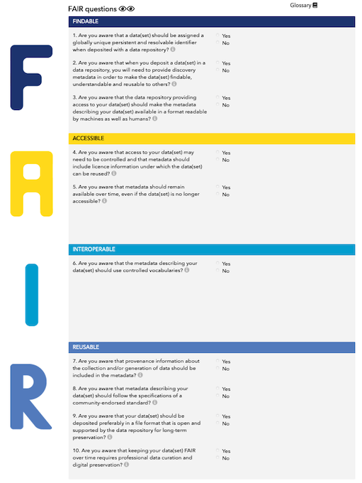
FAIR-Aware
For researchers and data stewards & also trainers!
Online tool to raise awareness and educate on the FAIR data principles
10 simple questions with practical tips to improve data FAIRness before deposit
https://fairaware.dans.knaw.nl
Notes:
Created in the FAIRsFAIR project to better facilitate FAIR assessment, the FAIR-Aware tool is designed to help people assess their own understanding of the FAIR principles and learn how to start applying them. By answering 10 simple questions and reading the guidance texts that accompany each one, users will have successfully taken the first step in the FAIRification process and will be ready to create FAIR data.

Slide 3
Key topics
Globally unique and persistent identifier (PID)
Metadata for citation and discovery
Metadata readable by humans and machines
Metadata includes licence, access level and access conditions
Persistence of metadata
Use of controlled vocabularies
Metadata includes provenance
Data in preferred format
Community-endorsed metadata standard
Digital curation and preservation
https://fairaware.dans.knaw.nl
Notes:
This self-assessment covers a range of FAIR questions. Each of them deals with particular aspects of making data FAIR.
Findability:
For example, a dataset should be assigned a persistent identifier (or a PID) which can be a digital object identifier link.
Discovery metadata. The rationale behind this principle is that someone should be able to find data based on the information provided by its metadata, even without the data’s identifier.
Format readable by humans and machines. When depositing data with a domain or discipline-specific repository it will likely be using common metadata standards. This means that others will be able to search and retrieve your data within your domain and potentially beyond your domain.
Accessibility:
Ideally, a dataset should be publicly accessible. For privacy protection or legal constraints, more restricted access levels can be chosen. In doing so it assures that data is as open as possible and as closed as necessary.
Persistence of metadata: Metadata will be preserved even when the data it describes may no longer be available. Trustworthy data repositories typically guarantee a minimum retention period.
Interoperability:
Using common terminology for specific disciplines helps find and bring data together easier. Controlled vocabularies ensure that the contents are unambiguous and can be interpreted automatically by machines. In turn, this enhances data search and interoperability of data from different sources.
Provenance information: To reuse data, researchers also need information about where data come from, how it has been collected, how it has been manipulated, how it has been documented.
Reusability:
Community endorsed standard: To ensure that your metadata can be broadly shared and understood within your research domain, it is recommended to use a community-endorsed standard.
Open or preferred formats: Most common software and tools support and widely used recommended formats. This ensures that your data can be read in the future.
Professional data curation and preservation: This ensures your data is properly managed and others can find and reuse it. Trustworthy digital repositories (TDRs), for instance, provide support and take responsibility of data with different levels of FAIRness.

Slide 4
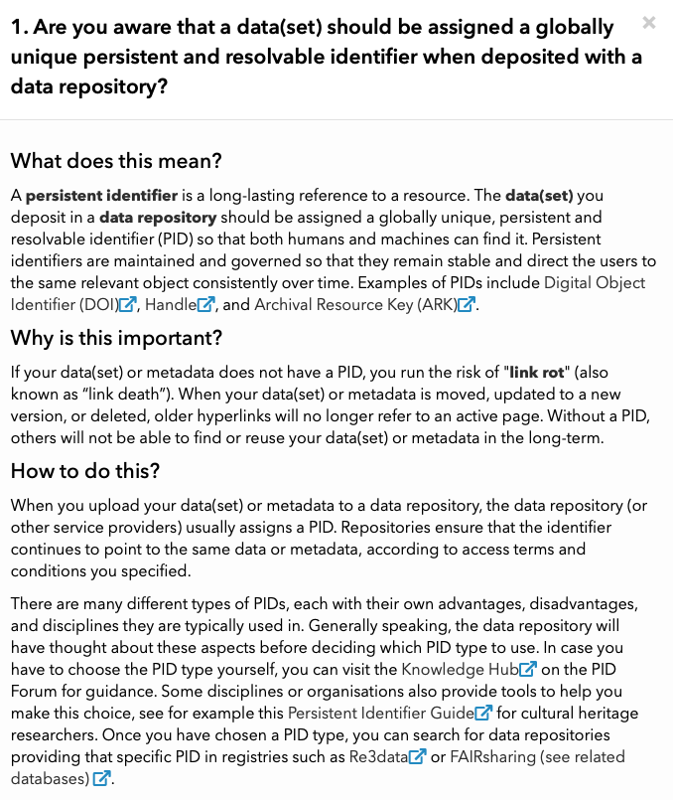
Helpful tips presented with each question
https://fairaware.dans.knaw.nl
Notes:
FAIR Aware has a range of helpful tips presented with each question. It explains the question in a simple way by poviding relevant examples and definitions. In addition to explaining the the importance of a specific question to making data(set) more FAIR, the tool also shows how to implement a certain practice in a real life situation.

Slide 5
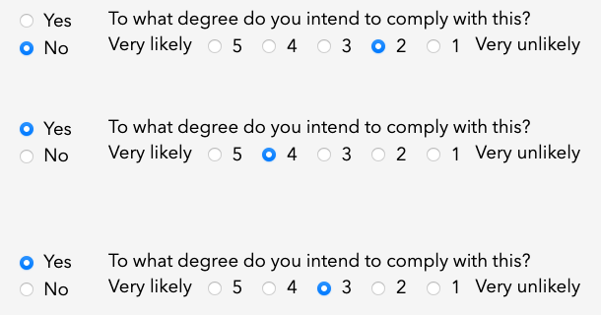
Asks researchers to think about their current practices
https://fairaware.dans.knaw.nl
Notes:
The tool also asks researchers to reflect on their current practices in terms of FAIR. On a scale of 1 to 5 (from very likely to very unlikely) they asssess themselves to what extent they intend to comply with a particular FAIr practice.

Slide 6
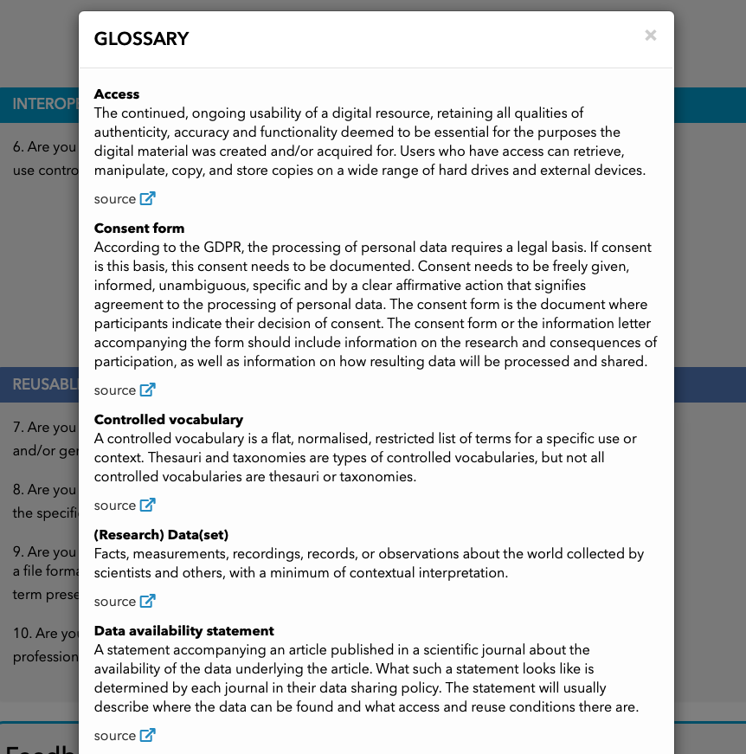
Explains key terms and definitions
https://fairaware.dans.knaw.nl
Notes:
The tool is equipped with a practical glossary which includes all relevant terms and definitions used in the questions and guidance tips.

Slide 7
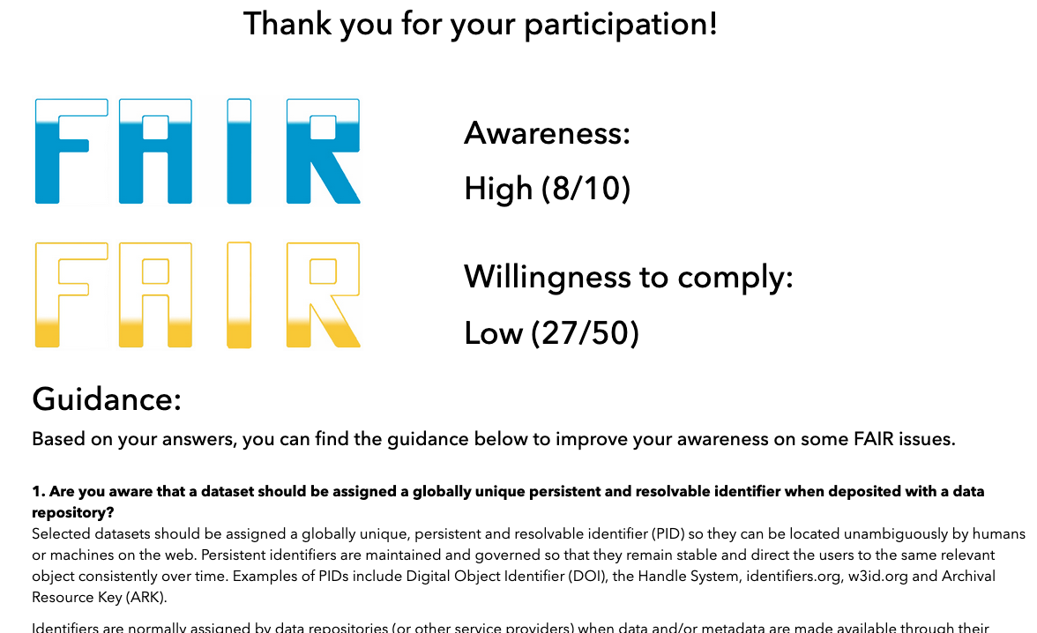
Provides an overview of awareness and willingness and suggestions for improvement
https://fairaware.dans.knaw.nl
Notes:
Once users have submitted their assessment, they receive an overview of their results. One of them indicates their FAIR awareness score and the other one shows their willingness to comply with FAIR practices. In addition, guidance texts are provided on the areas with the lowest scores on FAIR awareness.

Slide 8
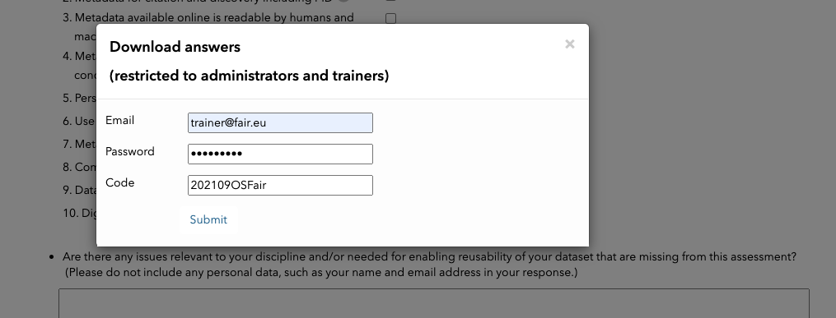
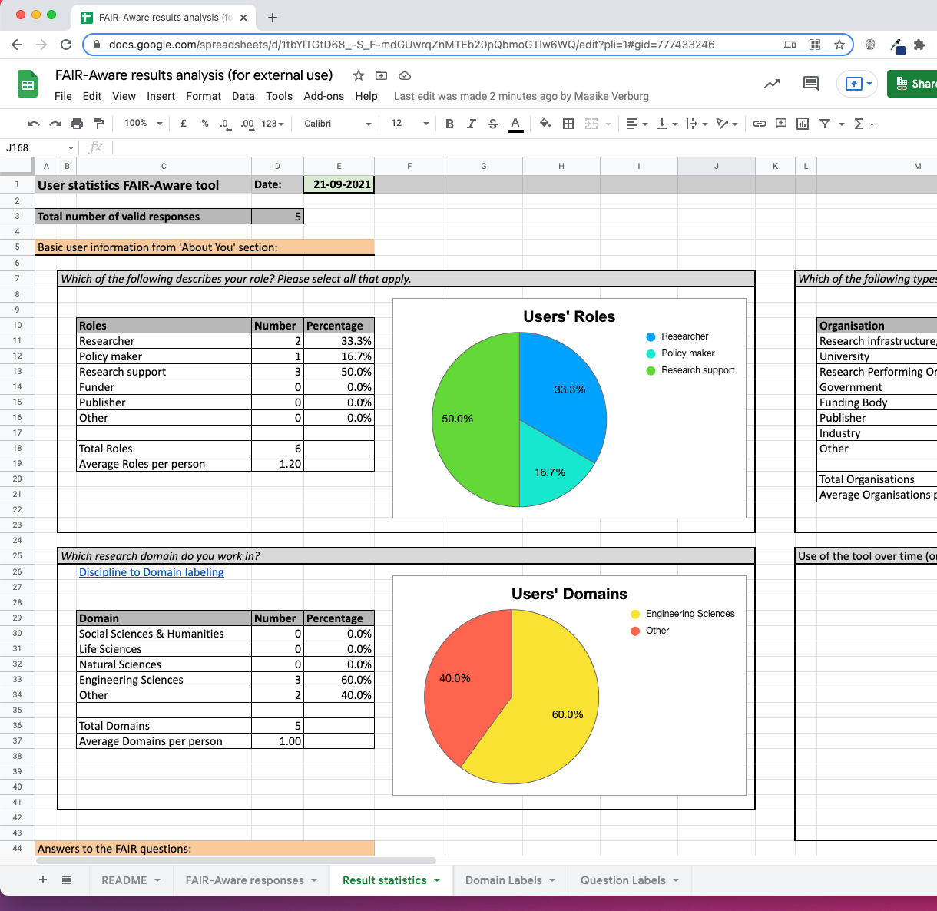
FAIR-Aware for training & research
Ready-made template to analyse results:
Overview of users’ roles
Overview of users’ domains
Overview of users’ organisation types
Timeline
Indication of awareness per question
Indication of willingness to comply per question
Difficult topics indicated
Assessment of FAIR-Aware tool
Difficulty per FAIR letter
Difficult topics split by domain
https://fairaware.dans.knaw.nl
Notes:
FAIR-Aware can be useful for trainers and researchers looking to assess the knowledge of the FAIR principles of their learners and improve the knowledge gaps.
By sending a request to the development team they can access the log in information to use the tool and analyse participants’ results. With a ready-made template they can quickly design useful graphs and visuals to analyse and report the assessment results as well as design a training to address specific knowledge gaps.

Slide 9
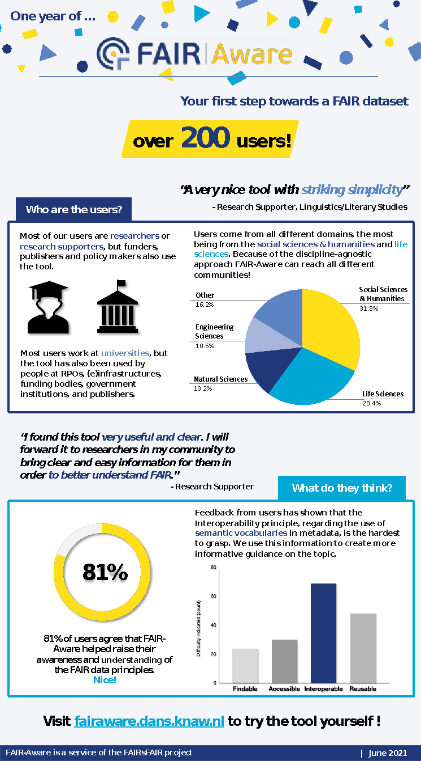
Current status
Continuous development throughout FAIRsFAIR
Focus on improving user-friendliness, guidance information, new functionalities
Dissemination in different communities
Image source: DANS (November 2021)
https://fairaware.dans.knaw.nl
Notes:
Launched in June of 2020, FAIR-Aware has seen over 200 users who have deemed the tool effective in increasing awareness and understanding of the FAIR Data Principles. The FAIR-Aware development team continuously incorporates the feedback users give to make the tool more informative and user-friendly. Since the tool is a self-assessment and has a discipline-agnostic approach, anyone working with data can use and learn from it.

Slide 10
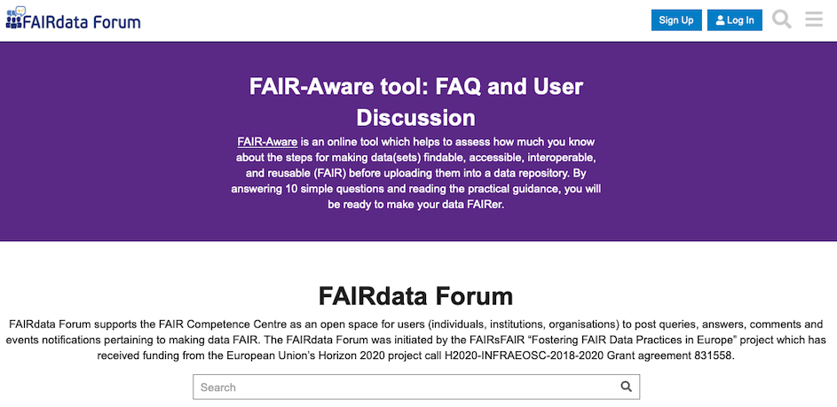
How can you make new data more FAIR?
Use resources to increase your knowledge and practical understanding (develop FAIR skills!)
Leave feedback about your experience and how the tool can be improved
Spread the word!
https://fairaware.dans.knaw.nl
Notes:
One of the desired effects of FAIR-Aware is to spark conversation within a community. Sharing the tool in a research group, organisation, or course can foster discussions about commonalities in difficulties, obstacles, or solutions that were encountered during the assessment. This is what makes FAIR-Aware especially suitable as a training material. With no prior knowledge expected, but guidance texts rich enough to teach something new to people more experienced with FAIR, the tool is an excellent exercise for any course or conversation regarding data management.

Slide 11
Useful links
FAIR-Aware tool
French version of FAIR-Aware
FAIR Data Forum – your gateway to learning about FAIR and FAIR data practices
F-UJI tool to assess FAIRness of datasets
Notes:
Here you can see an overview of relevan links to FAIR-Aware tool including the French version of the tool, the FAIR Data Forum, and the F-UJI tool.

Slide 12
Thank you
Questions?
Drop us an e-mail at: fair-aware@dans.knaw.nl
Notes:
Thank you for listening to the presentation. I hope you found it interesting and useful.
If you have any questions, please feel free to e-mail us.

